Slide 1

What Questions Does MAp Ask?
What are the properties of the box visible at its boundary?
functionality: services offered and
required, events handled,
information handled
others: volumes, performance,
location, security, tech platform
What is the bigger
goal being achieved outside?
How is our box combined with other parts to solve it?
Are there better approaches?
What is the boundary of the “box”
we are describing?
Workers
Policies
Our Box
Resources
What internal “boxes” can be combined to do the job?
Existing? New?
How to partition behavior and information responsibility to meet end-to-end needs?
What are the properties of each internal box?
functionality: services offered and
required, events handled,
information handled
others: volumes, performance,
location, security, tech platform
What consistent principles, patterns, or styles guide our design and are shared across components?
How should we document all these?

Slide 2
What Questions Does MAp Ask?
What are the properties of the box visible at its boundary?
functionality: services offered and
required, events handled,
information handled
others: volumes, performance,
location, security, tech platform
What is the bigger
goal being achieved outside?
How is our box combined with other parts to solve it?
Are there better approaches?
What is the boundary of the “box”
we are describing?
Performance
Technology
Security
Functionality
Our Box
Resources
Workers
Policies
What internal “boxes” can be combined to do the job?
Existing? New?
How to partition behavior and information responsibility to meet end-to-end needs?
What are the properties of each internal box?
functionality: services offered and
required, events handled,
information handled
others: volumes, performance,
location, security, tech platform
What consistent principles, patterns, or styles guide our design and are shared across components?
How should we document all these?

Slide 3
MAp Viewpoints
Information supports goals, process
Process supports goals
Need shared vocabulary
Business
Architecture
goal1
1
goal2
goal3
Outside
Information
Goals
Behavior
Goals – success criteria
Traceability
Black-box use cases and info
model support business model
Three primary viewpoints
Application Architecture
Black box view (of S)
1 (or more) black boxes
1
2
S
1
S
S
D
Boundary
E
4
Architecture Styles: Principles, Patterns, Guidelines, Rules
S: Information
S: Behavior
3
White box view of S
sub-component 1…3
Black box view of S
Styles across viewpoints, projects:
workflow partitioning style
escalation business process style
Black-box behavior and info model
partitioned into sub-components
1
2
S
S
Application Architecture
White box view (of S)
Inside
3b
3a
4
Information
Behavior
Each sub-component serves as black box for next level of drill-down (if needed)

Slide 4
Multiple Concerns, Styles, across Viewpoints
Module: build-time structure of software units including sources and tools
Location: locations, connectivity of people, processes, hardware, software
Technical: technical and platform realizations of components, ports, connectors
Concerns
Performance: throughput, response time, latency, data volumes, loads
Security: who can and cannot do what and to whom
Logical Functionality: what actions with what information
1. Business Architecture
Business perspective on the problem or concern, including goals, activities, interactions, and information.
Outside
Architecture Styles: Principles, Patterns, Guidelines, Rules
Viewpoint
2. Application Architecture
– Black Box
Describe a large grained software component as a black box, with its behavior and information responsibility to others in its environment, for any aspect that is externally visible.
Boundary
3. Application Architecture
- White Box
Design the “insides” of a black box component as a collection of connected sub-components, each a black-box, and decide how they collaborate to fulfill black box responsibilities.
Inside
Address all relevant concerns early in the process and in the appropriate viewpoint
Notes:
REVISIONS:
Add summary of UML diagrams used.

Slide 5
Architecture Principles and Styles
Architecture principles and styles define preferred architectures
Very wide spectrum of styles in all viewpoints
  Earliest point of data capture: capture data at earliest point in a process
  Workflow coordinator style: partition components and co-ordinate flows
  Coexistence Bridge: replacement and legacy apps coexist using replication
  Replication and heartbeats styles: maintain availability through failures

Slide 6
Architecture: Good and Better
Architecture: An architecture of a system from a viewpoint is
  a model of that system
  that we hope is a correct description of that system
  using the language of that viewpoint
  that describes system properties that are of concern to that viewpoint
    explicitly described in the model, or
    implicitly described via language-defined analysis and inference
A good architecture is one that is effective at meeting its goals

Slide 7
Architecture in Context
What architecture styles better meet goals?
Architecture Styles
Knowledge
Patterns
Principles
Refinements
Transformations
Goals
Objectives
Problems
Needs
Requirements
Constraints
the “real” problem
possible solution
solution approaches
lessons learned
Architecture
How best to deploy the changes?
Domain/System
Running
Operating
In the Real-World
implement, deploy, operate
conforms to, reverse engineer, adaptive feedback
How well is the system meeting goals?
The architecture of a system is a key determinant of
how well a running system will meet business goals

Slide 8
Initial issues, objectives, stakeholders, etc.
refine goals and obstacles
for target state work
formalize problem, syndicate with stakeholders
Goals model Key domain terms
known reference architectures,
best practices, etc.
top-level requirements,
priorities, focus areas
Current State
Target State
Business architecture
scenarios
sketch of processes, roles,
and activities
key information terms
problems and opportunities
Business architecture
principles and styles
processes, roles, activities
validation vs. goals and obstacles
problems and opportunities
Application architecture
context: external actors, use cases
scoped information types
non-functional and technical props
principles and styles
[internal] partition and layer styles
[internal] sub-component assembly
[internal] end-to-end collaborations
sub-component specs: info, behavior
technical properties, mapping styles
validation vs. goals and obstacles
target reference architecture
e.g. components, functions,
information … for inventory
Application architecture
application inventory
(against target reference)
non-functional and technical props
problems and opportunities
Plan and Migration Plan
relationship to other roadmaps and projects
goals, constraints, architectural sequencing dependencies
migration principles, stages: evolving architecture snapshots with gaps,cost
cross-project
“program” conformance
project funding
project requirements
project funding
project requirements
project funding
project requirements

Slide 9
Goals Drive Other Architecture Decisions
Goals modeling drives out other goals, assumptions
  Constantly evolve the portfolio of products to optimally meet customer need
  Why? → higher level goal: provide optimally aligned customer-experience
  How? → evolving portfolio of products is not itself sufficient to meet higher goal
Goals drive the top level architecture choices, alternatives, refinements
  What is the essential connectivity between top-level black boxes?
  What changes to components and connectors help meet the goals?
Goals drive the broad structure and detailed specification of processes
  What should be essential processes themselves?
  What should be the top-level boundary of each process?
  What should be the top-level interactions between those processes?
  What are the essential activities within each process?
  What are the specifications of each activity i.e. when triggered, prohibited, etc.

Slide 10
From Goals to Top Level Components, Connectors
Each Goal refers to certain elements of the Information Model
  Manage Portfolio: Constantly evolve the portfolio of products to optimally meet customer need
Some of these elements are controlled, others are observed
  customer need - observed
  portfolio – controlled
These elements may be owned elsewhere in the enterprise
  customer need – owed by Application-1
  portfolio - owned by Application-2
Essential connectivity between components spelled out by goal itself
Manage
Portfolio
customer need
portfolio

Slide 11
Clarity → Deeper Goals, Better Architectures
What constitutes “Customer Need”?
  What are different roles a customer plays?
  How do they contribute to his/her needs?
  What different roles other objects related to Customer play?
  How do those contribute to Customer’s need?
Customer
need = ??
Role 1
Role 2
Customer’s Daughter
college plans?
Customer’s Father

Slide 12
Domains to Architecture
These are models of the Problem Domain itself
  Not of any existing piece of software
  Perhaps not directly of any to-be piece of software
  But essential to understanding what things in domain have to be monitored, controlled
  And, by refinement and architecture styles … what processes? Technologies?
??
??
Manage
Portfolio
??
customer need
portfolio

Slide 13
Precise “meet” → Product Domain Model
Manage Portfolio: Constantly evolve the portfolio of products to optimally meet customer need
What is optimally meet ?
If product-A meets need-A …
And product-B meets need-B …
How does a composite product A+B meet some combination of need A+B
??
Composite Product

Slide 14
And How About That Dashboard?
DASHBOARD
What information?
From where?
Goal: Optimally Meet Customer Neet
Attributes?
Sub-Goal 1
Sub-Goal 2
Attributes?
Even high-level goals can be made as clear and precise as necessary
Goals are refined …
Systematic approach to dashboard definition

Slide 15
Refining Goals and Components
Refine goals
  Common patterns for different goal types
  Common patterns to resolve obstacles
Refine architectural components and connectors
  Common patterns to decompose
  Common patterns to map to Platform-Specific realizations
Capture common patterns as (refinement) architectural styles
  Some may be fully automated transformations
TIBCO bus style
G1
Rationale
G2
Y
avoid(Z)

Slide 16
Refining Goals and Business Process Design
“Essential” entities with interesting lifecycles in Customer Service
  Customer, Issue, Service
Corresponding reference processes
  Customer, Coordinate Customers, Customer Strategy
  Issue, Coordinate Issues, Issue Strategy, …
  Service, Coordinate Services, …
Reference process architecture ties these together
  Arrows do not imply sequence, but summarize inter-process interactions at lower level
monitor, improve
Customer Strategy
monitor, improve
Maintain Patient
onboard,
retire,
allocate rep
Customer
Coordinate Customer
deliver visit
issue request
Coordinate Service
start,
stop,
redo
Maintain Patient
Service
Maintain Patient
new issue,
re-schedule
Issue
Coordinate Issues

Slide 17
From Goals to Business Processes
Goals uncover the basic information model of the domain
Essential information types seed lifecycle-centered processes
Case / coordination / strategy pattern centered around essential types will provides a basis for top level process partitioning
Goals then identify activities in the processes, and all the constraints on those activities …

Slide 18
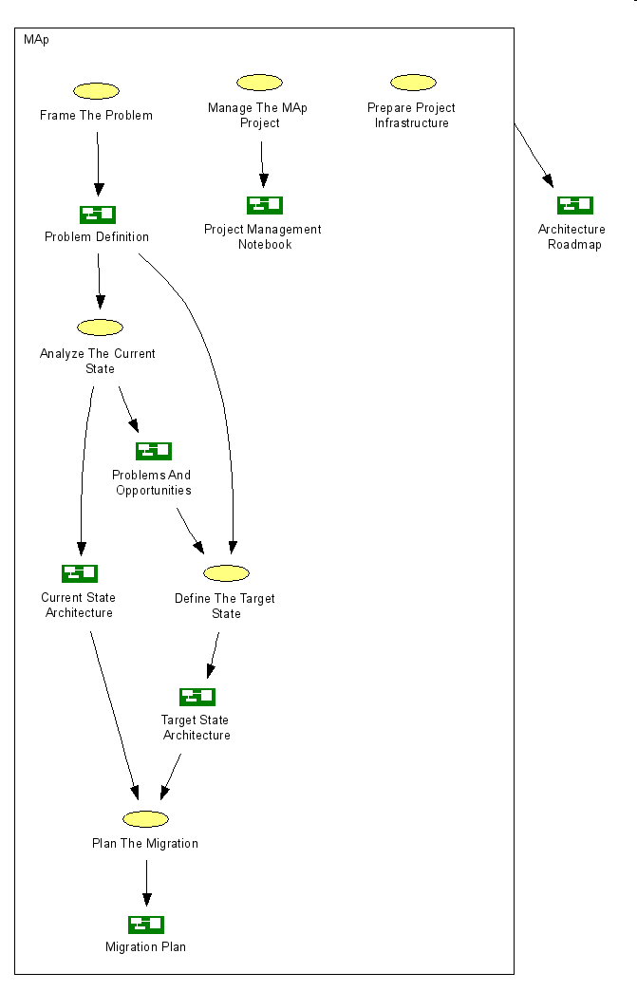
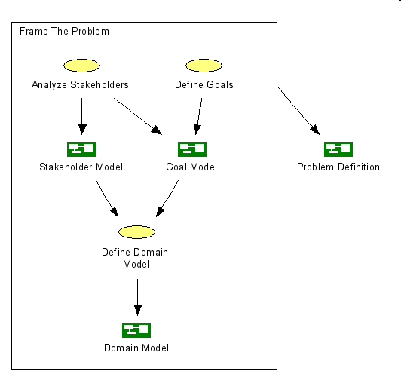
Doing Map, Framing The Problem

Slide 19
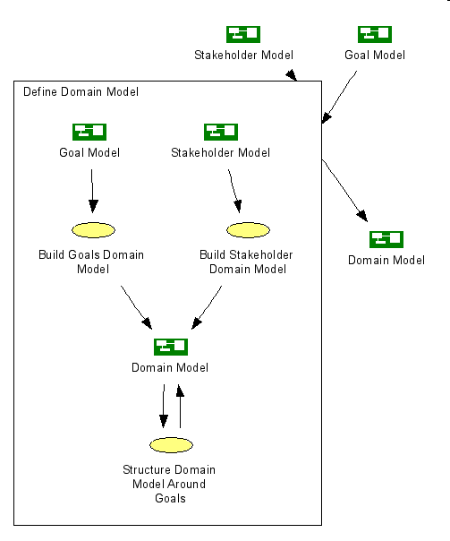
Understanding A Domain

Slide 20
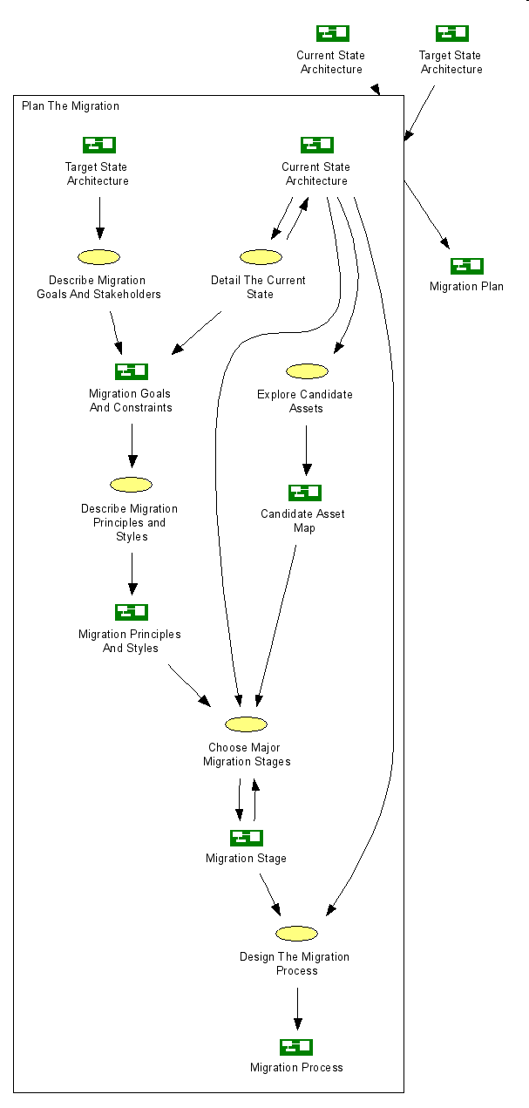
Migration Planning
Problem: go from Current to Target
With
  These goals
  These constraints
  These stakeholders
Who care about
  This domain
Sound familiar ?

Slide 21
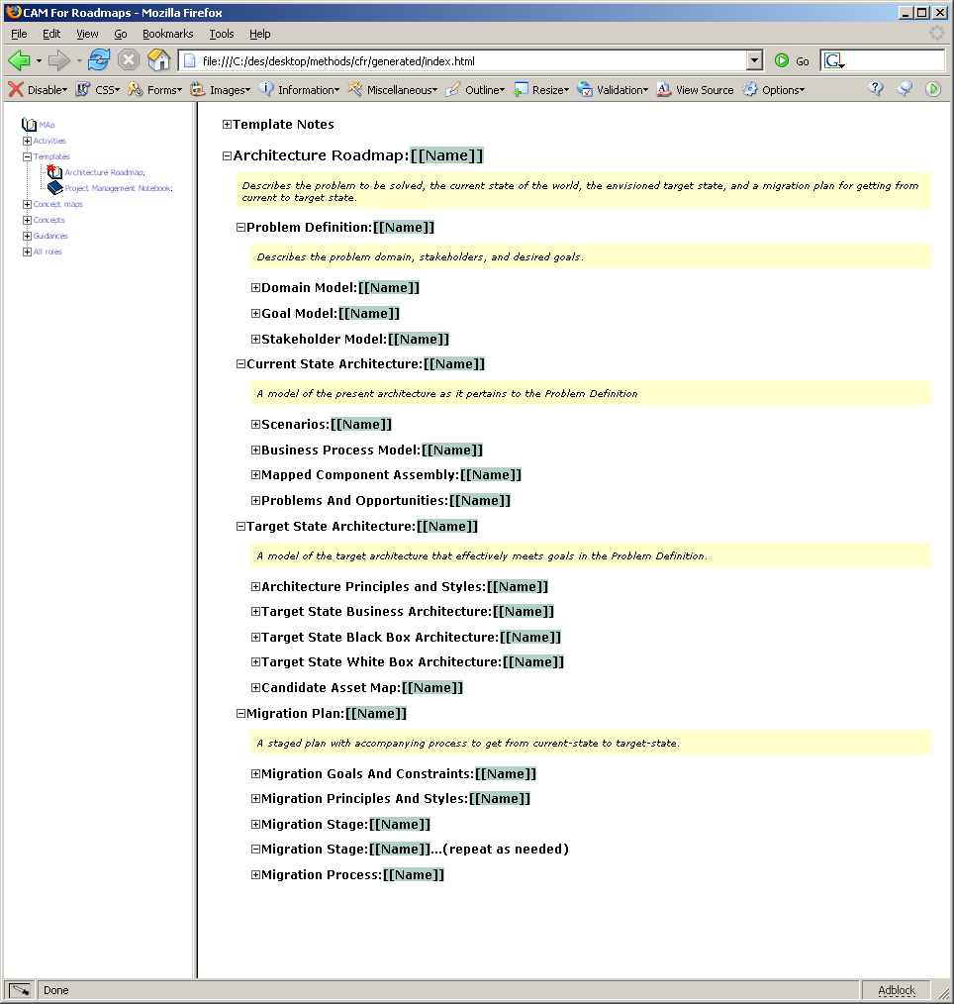

Slide 22
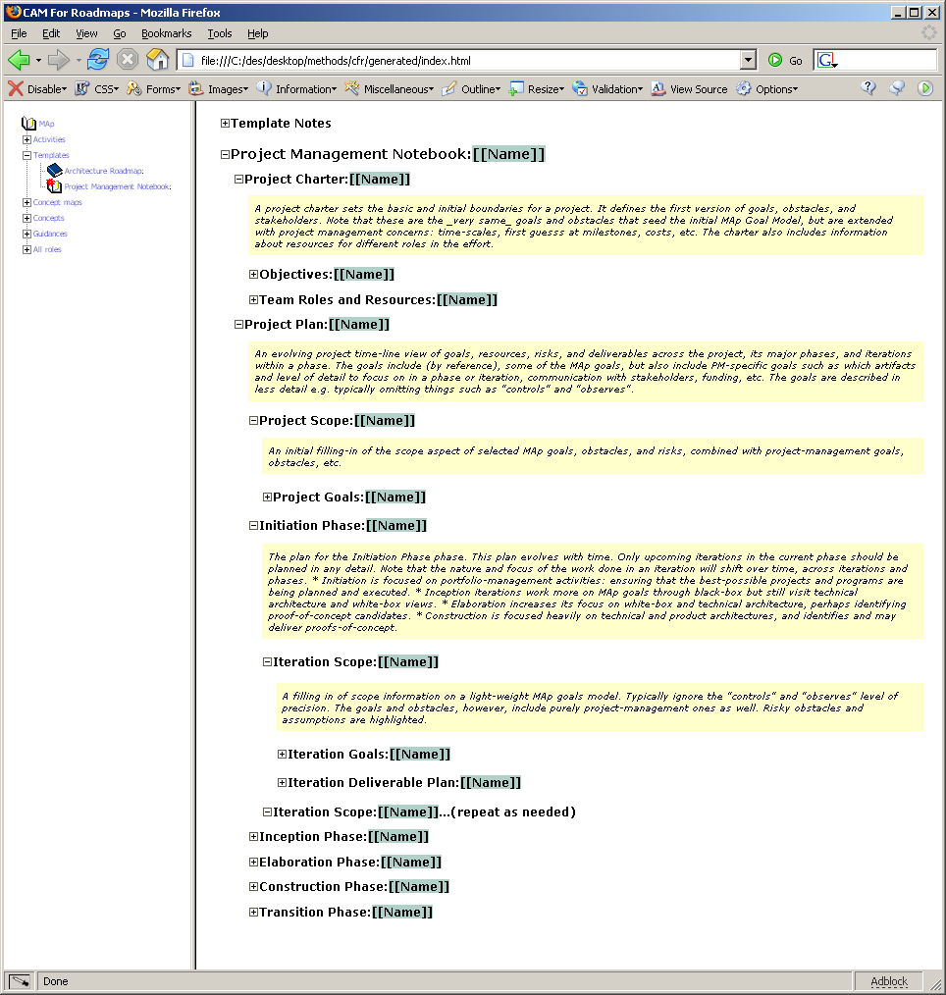

Slide 23
How to choose? → Goals, ultimately linked to Biz Goals and Domain
How to express? → Arch Lang, styles, conformance
What are domains? → Goals, Business Domains vs. Tech Domains
How to map from apps, tech to business? → Domain maps, goals
How to know how well we are doing? → Dashboard
How to structure? → Goals, corresponding sub-domains
Levels within GCG: Biz Domain? Apps? Tech? Tools? Styles?
Conforms? Supports?
Target
GCG
time
Conforms? Supports? How to map?
Conforms? Supports? How to map?
BU
BU
BU

